Slide 1
Workshop Pattern Generation
Loe Feijs for Digital Craftsmanship 2025
Part 2: week of laughters

Slide 2
Workshop Pattern Generation
Loe Feijs for Digital Craftsmanship 2025
Part two: week of ..
inspired by “dear data”
week of laughter
week of schedules
Comic by Figline Valdarno Francesca, Toscana, Italy /www.idm314.org/2023-comic-challenge-gallery#d/2/2023-cc-photo-694

Slide 3
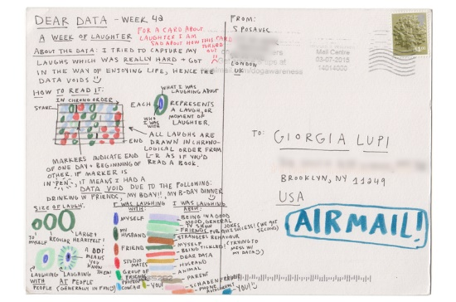
Get inspiration: Georgia Lupi and Stefanie Posavec
http://www.stefanieposavec.com/dear-data
http://www.dear-data.com/week-42-a-week-of-laughter

Slide 4
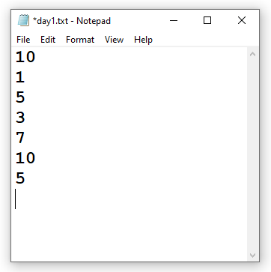
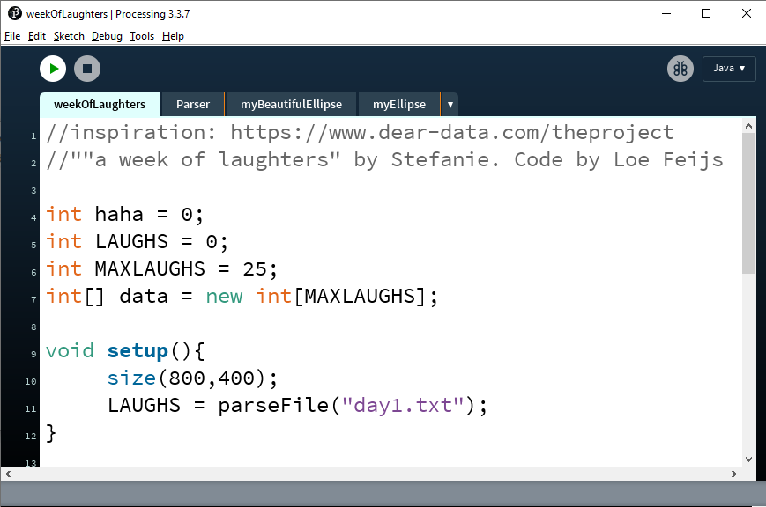
Import data

Slide 5
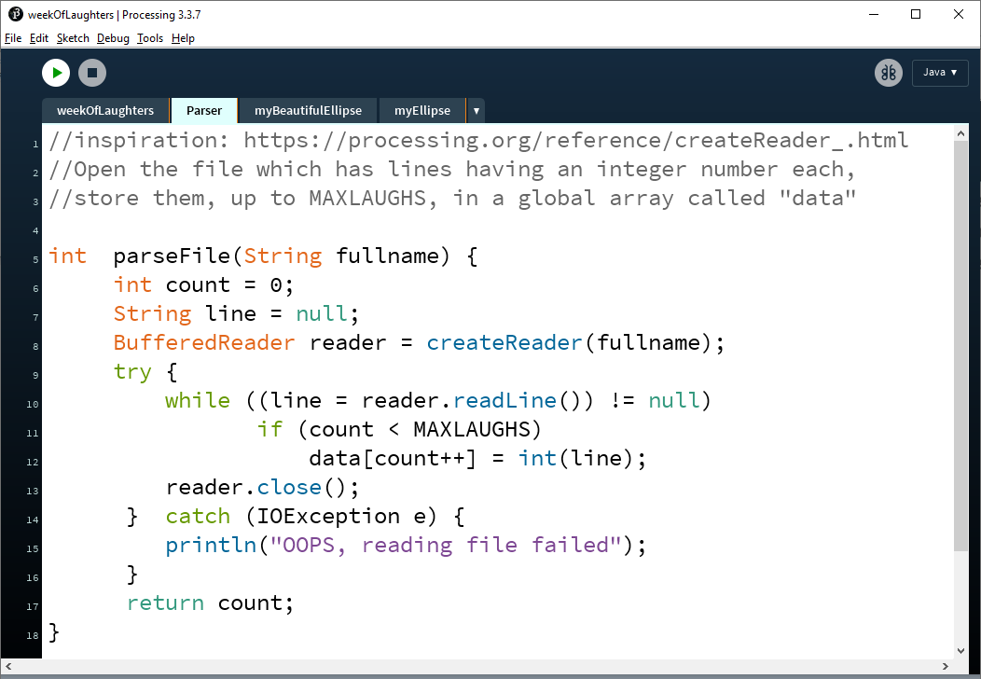

Slide 6
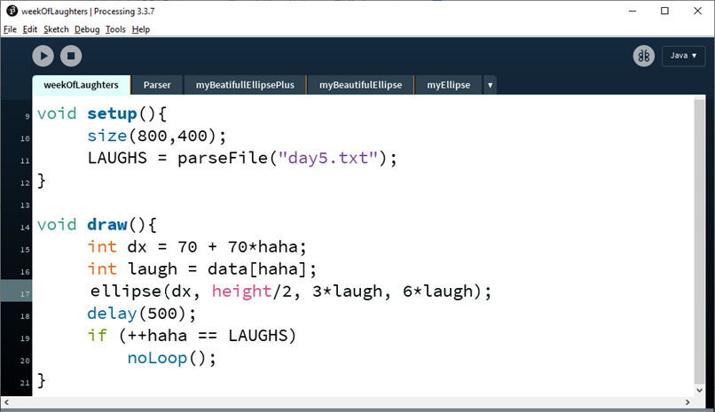
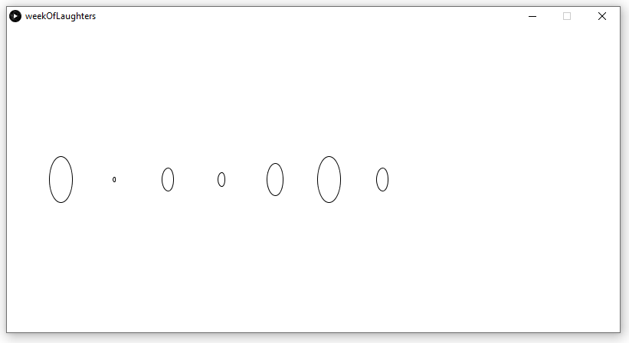

Slide 7
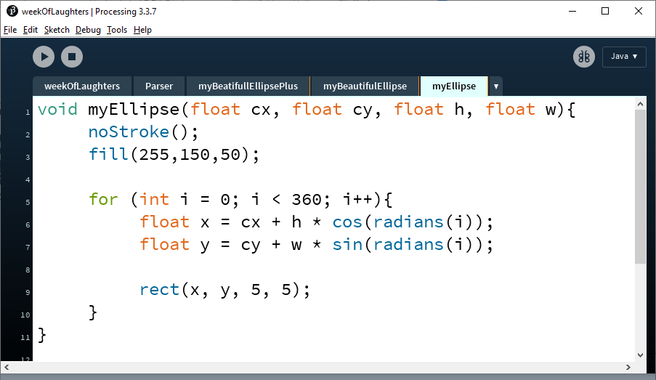
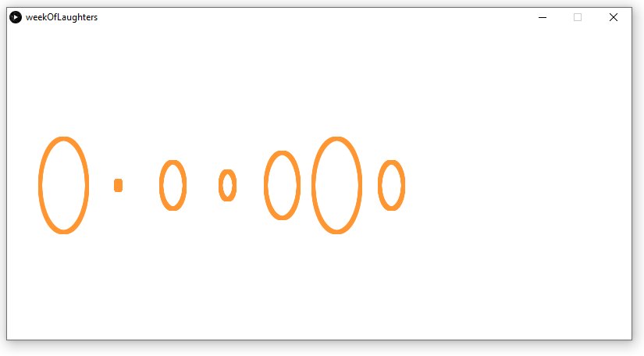

Slide 8
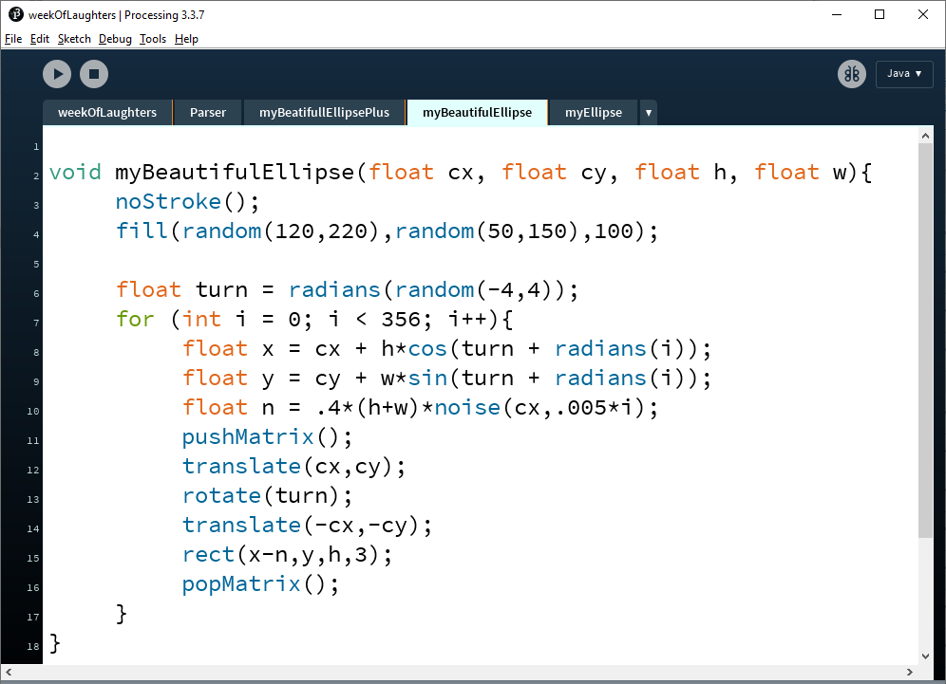

Slide 9
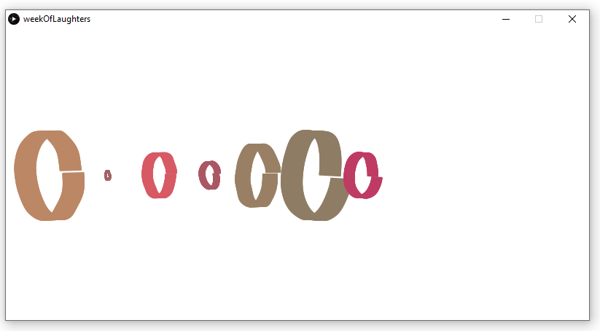
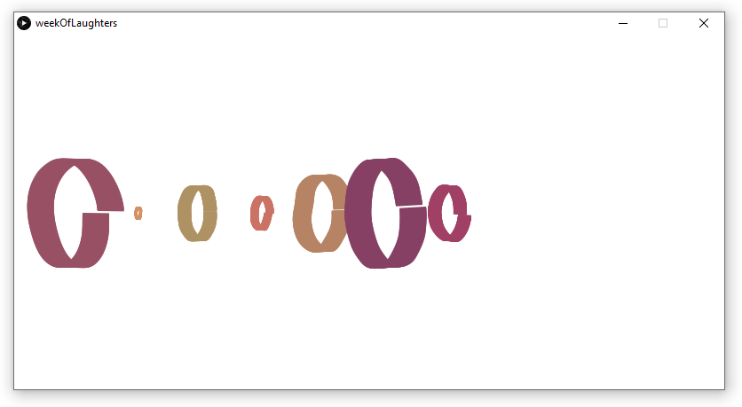

Slide 10
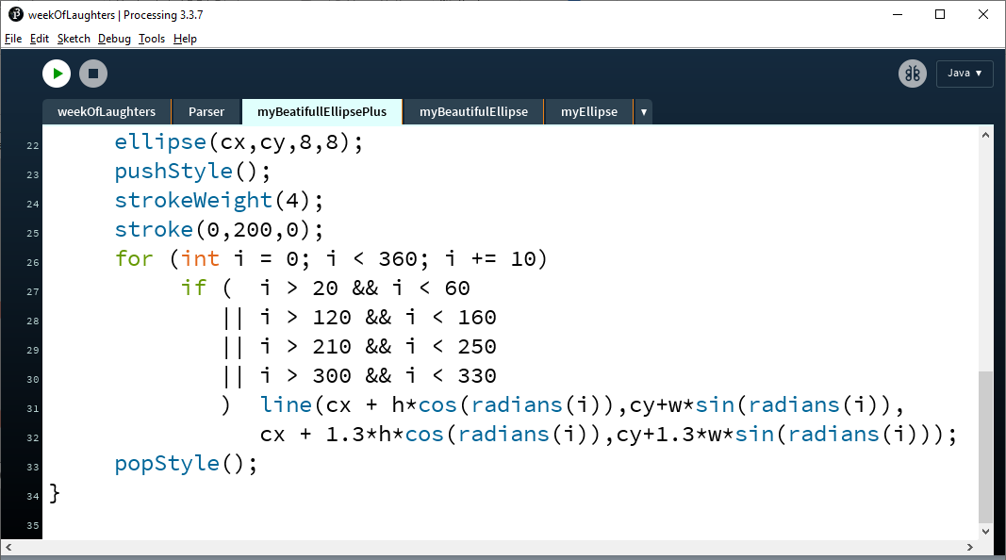

Slide 11
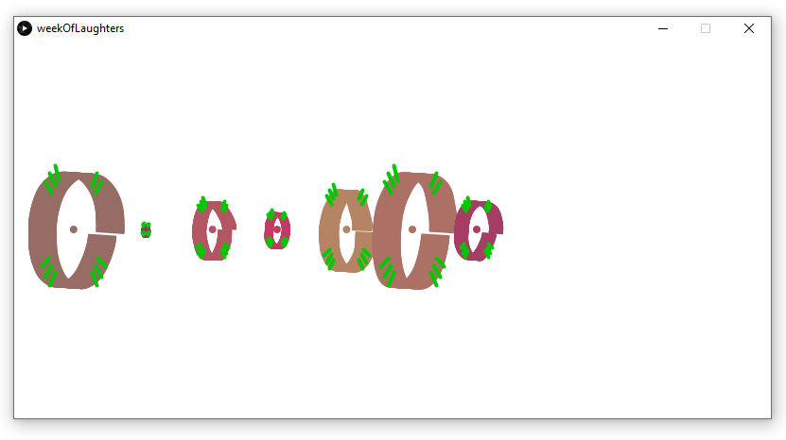
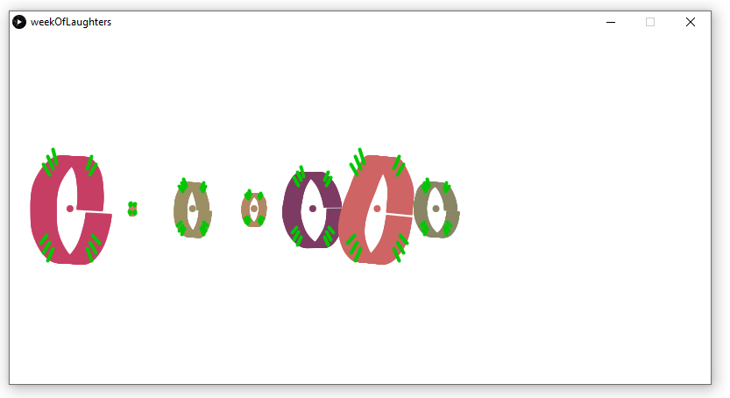

Slide 12
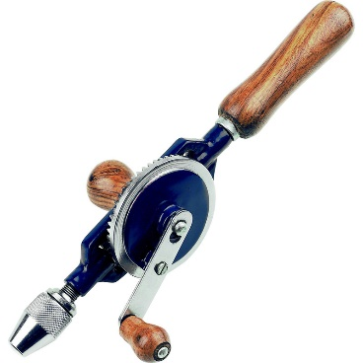
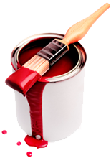
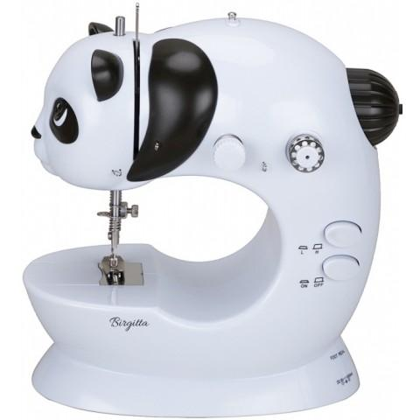
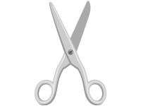
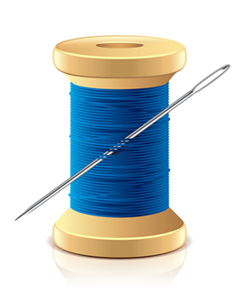
How to get started yourself?
Get Processing running
Read a file with numbers, n1, n2, n3
Produce random lines in different colors
n1 red lines, n2 green lines etc.
Develop some aesthetics
Make it meaningful
Make it physical

Slide 13
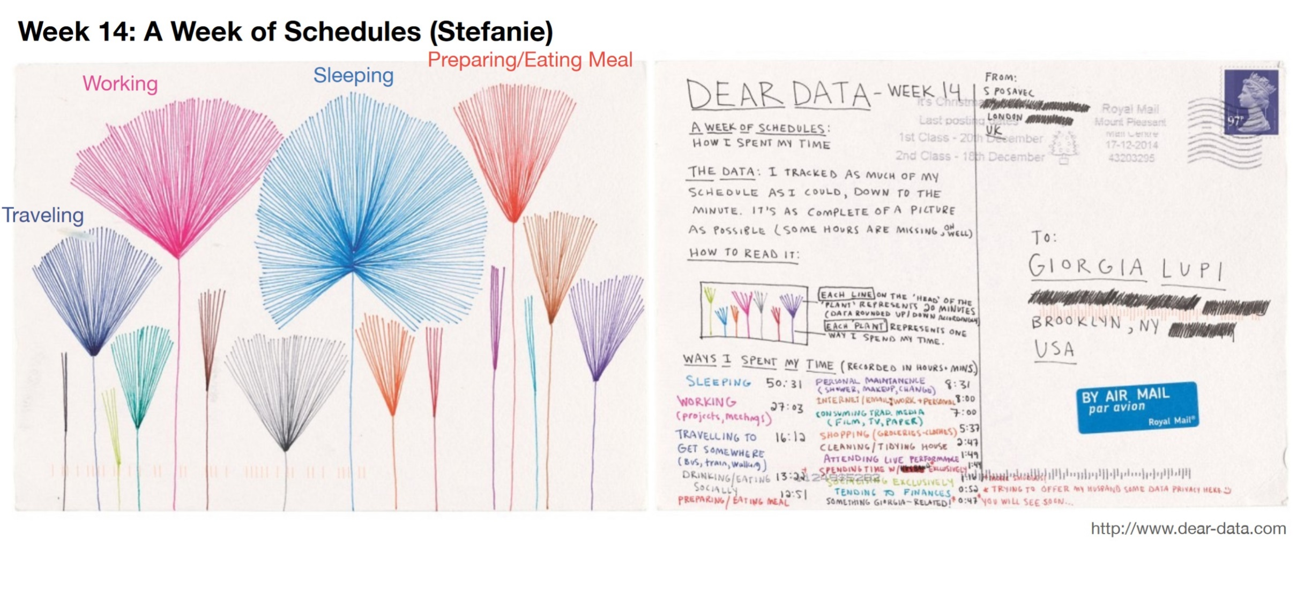
Get inspiration: more beautiful data

Slide 14
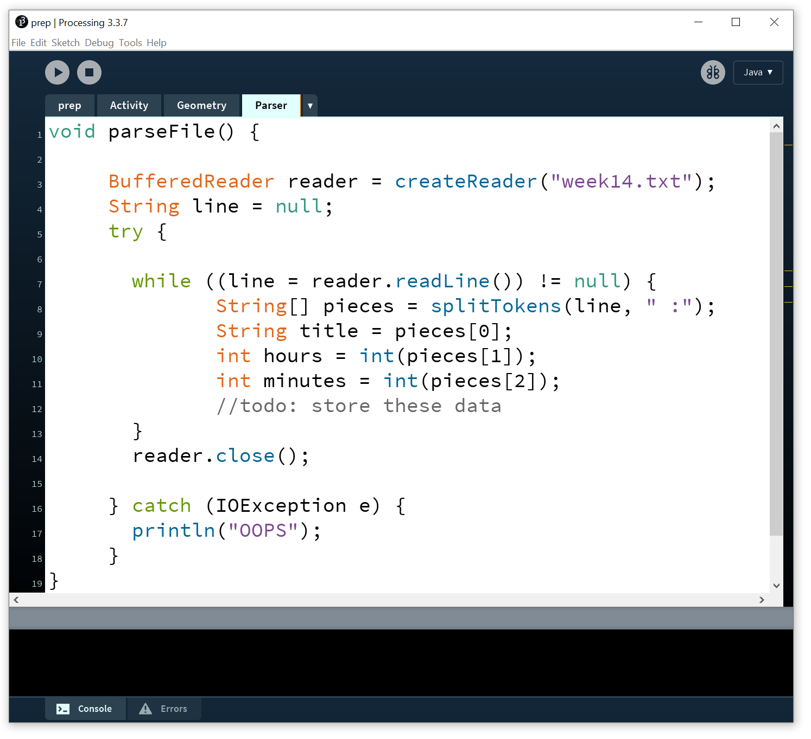
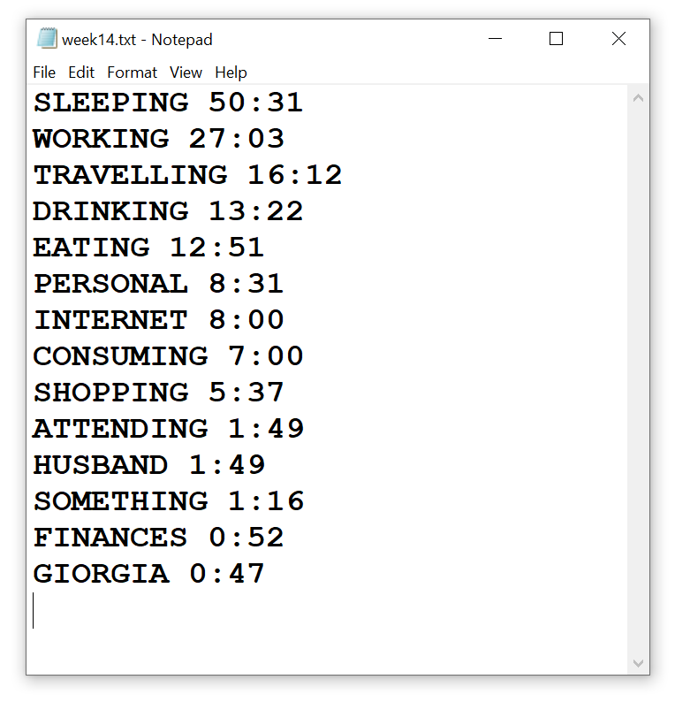
Import data

Slide 15
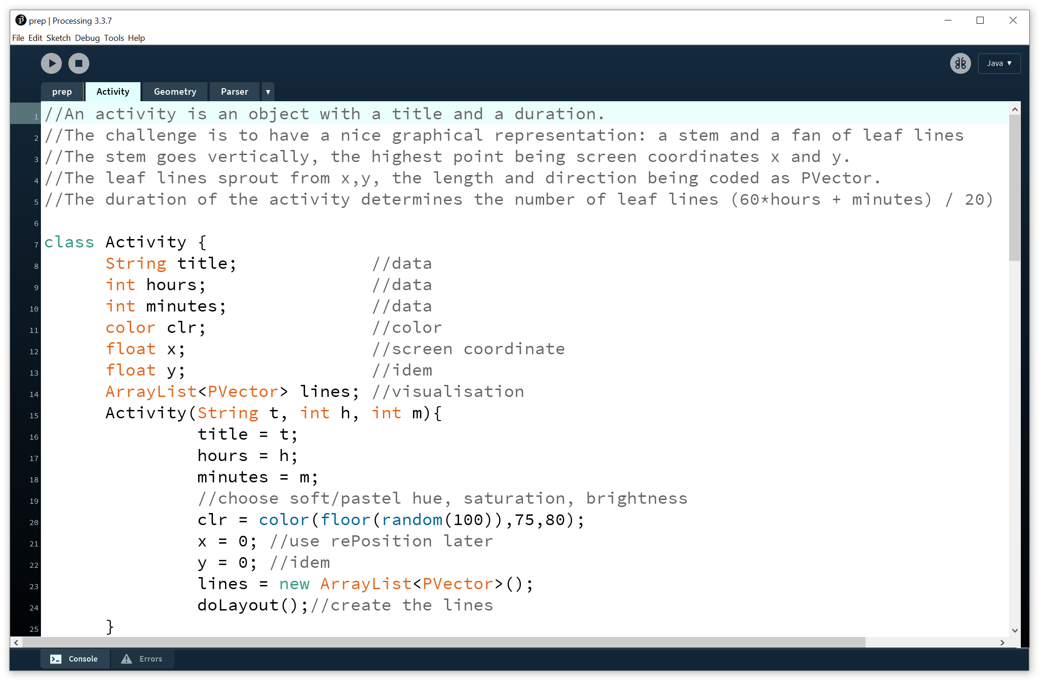
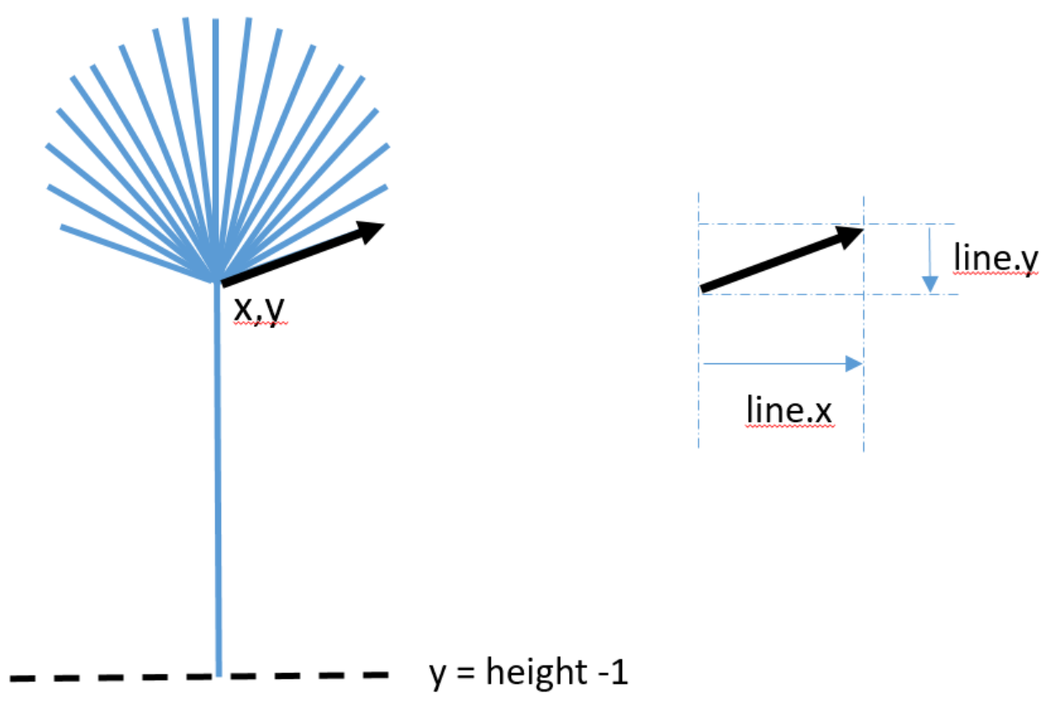

Slide 16
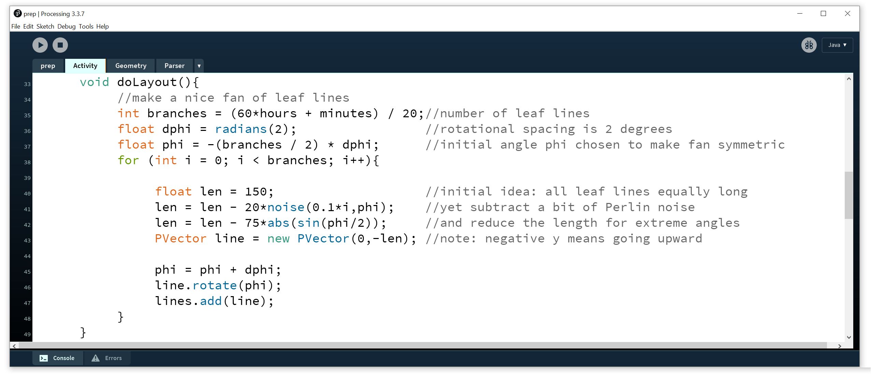
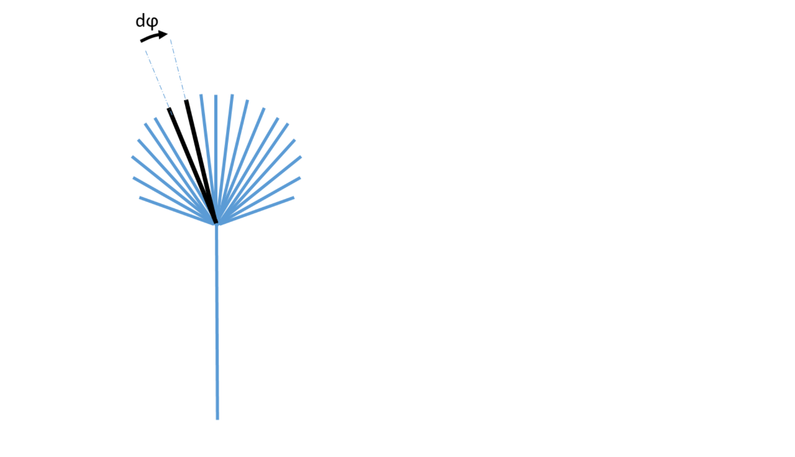
Produce rich patterns

Slide 17
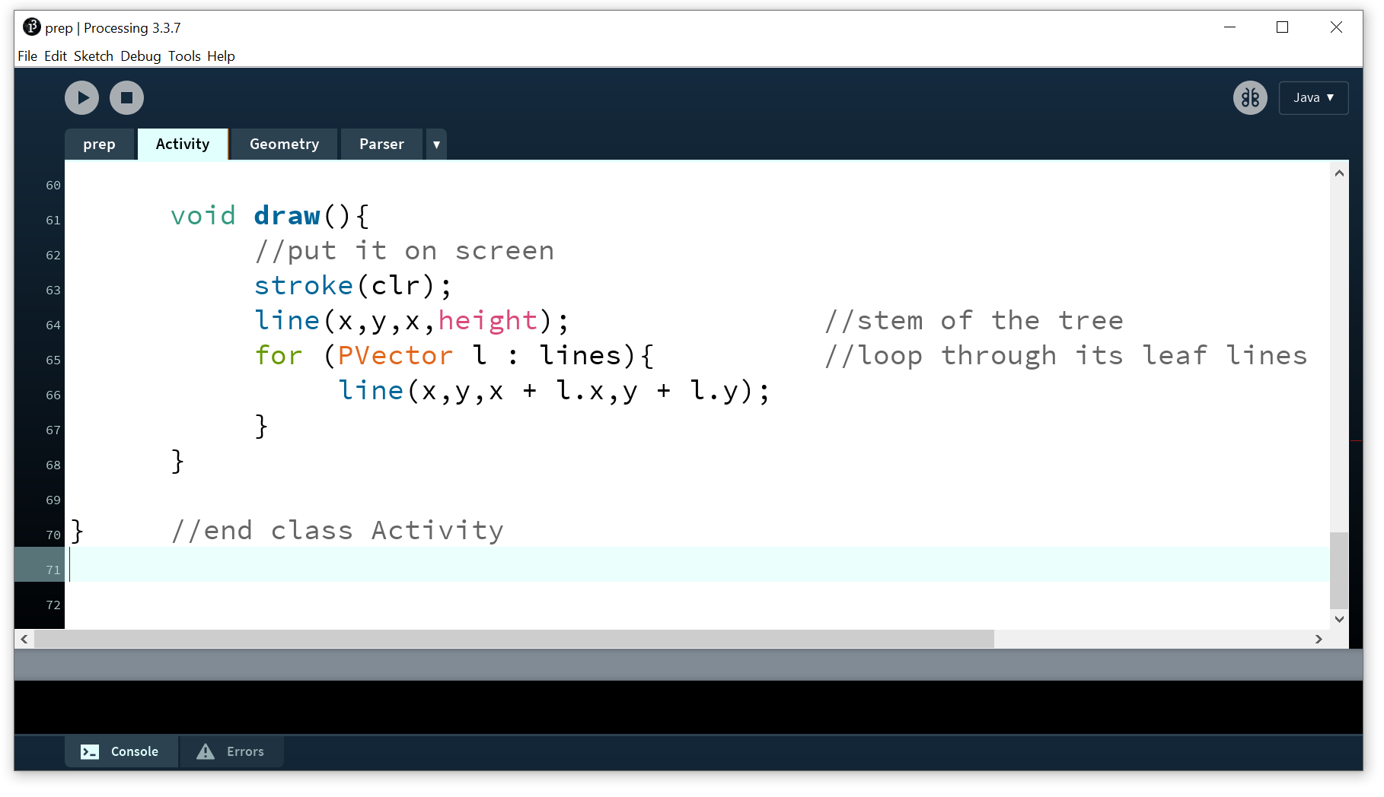
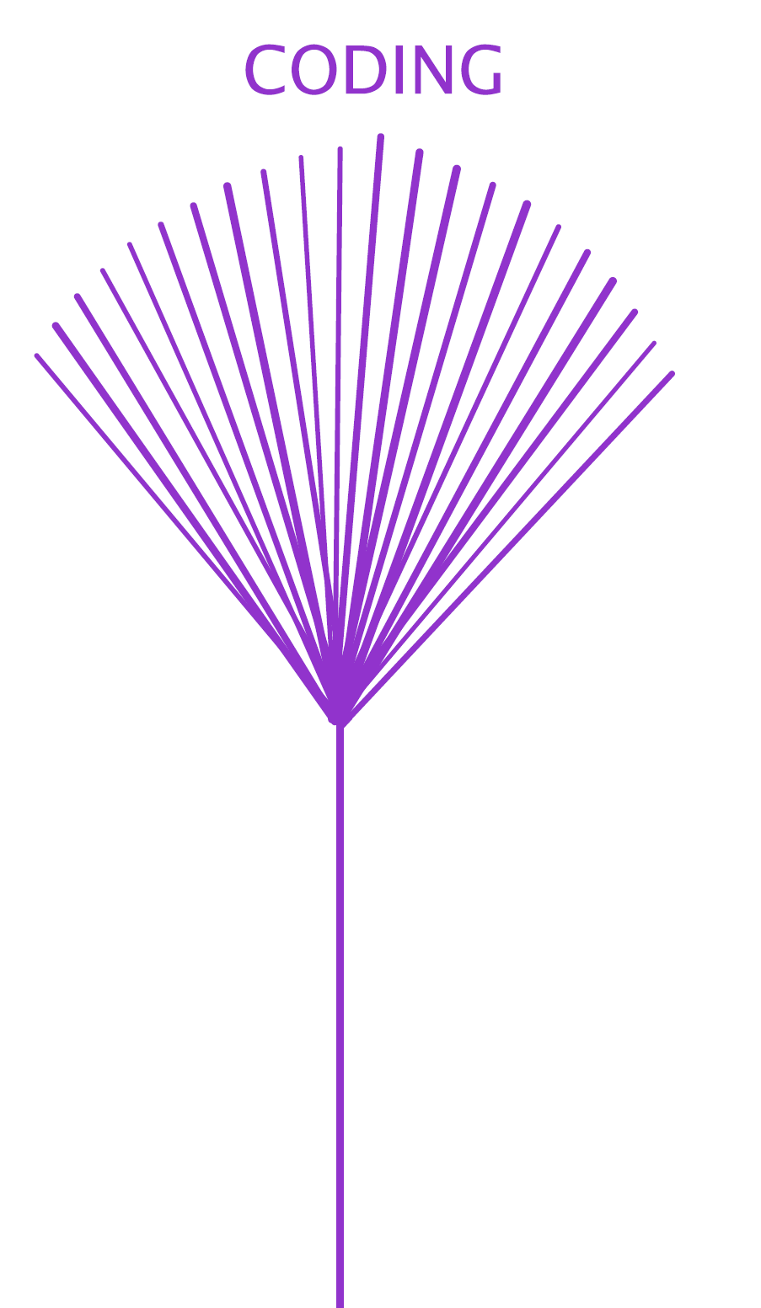
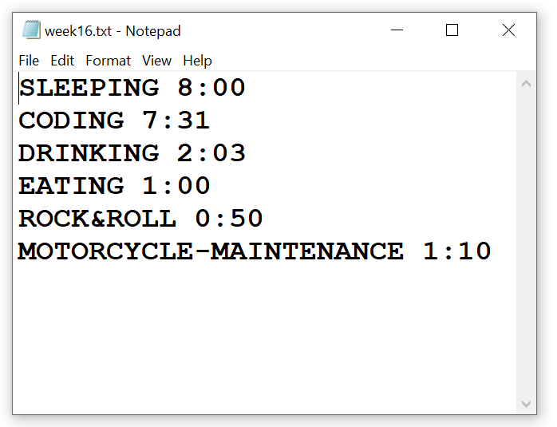
Actually I added a bit more noise
and added the activity’s title as text

Slide 18
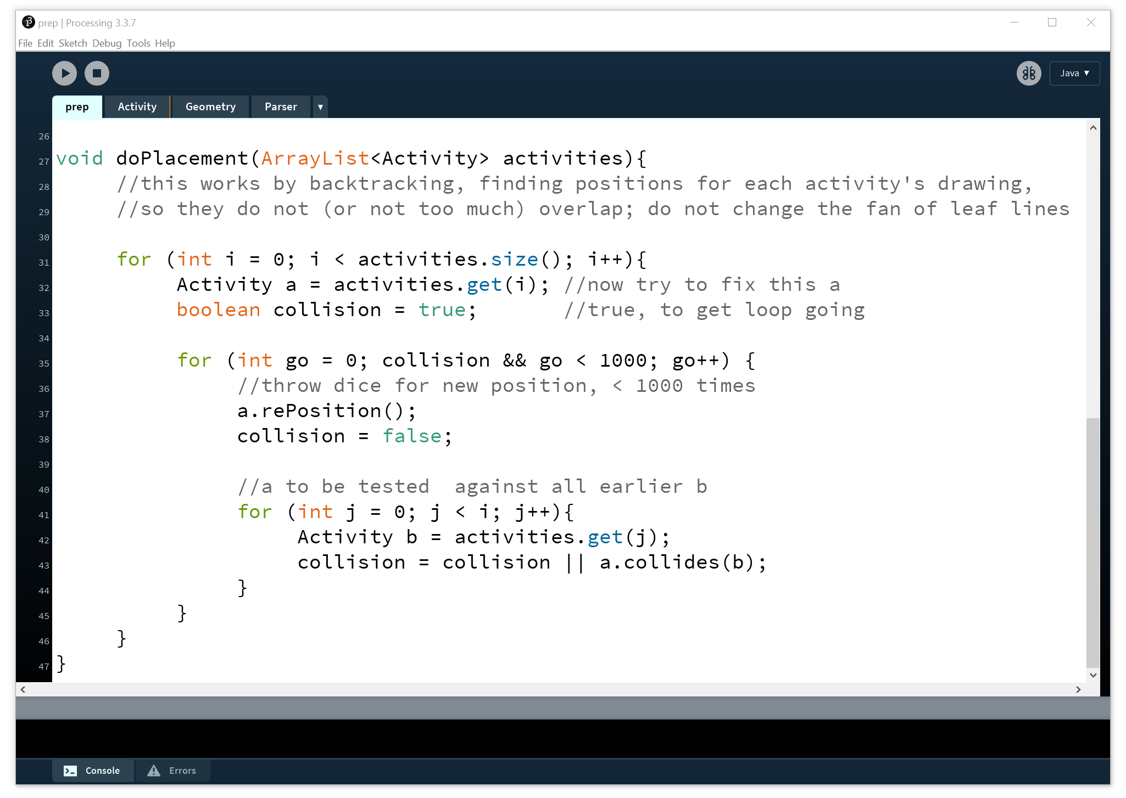
Avoid overlapping objects
collision

Slide 19
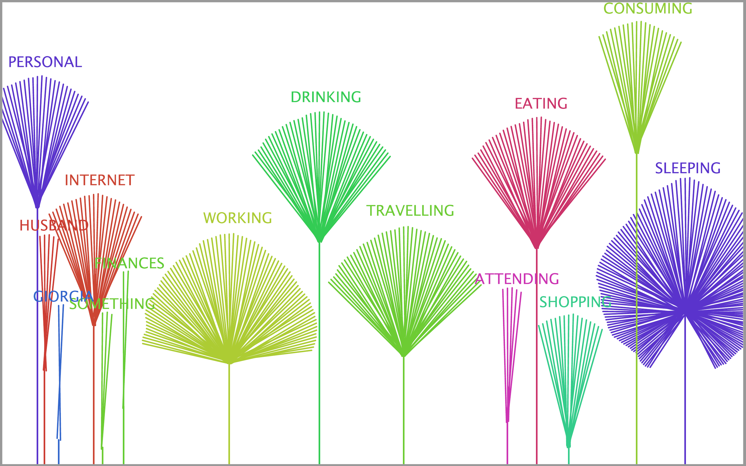

Slide 20
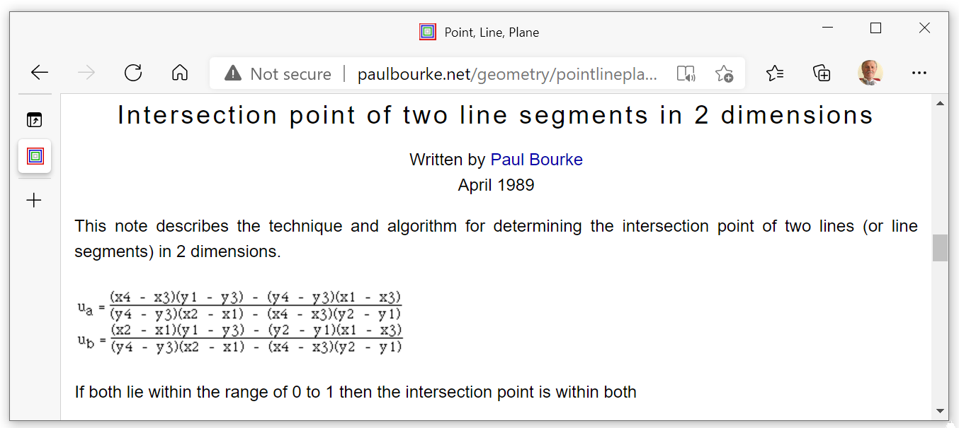
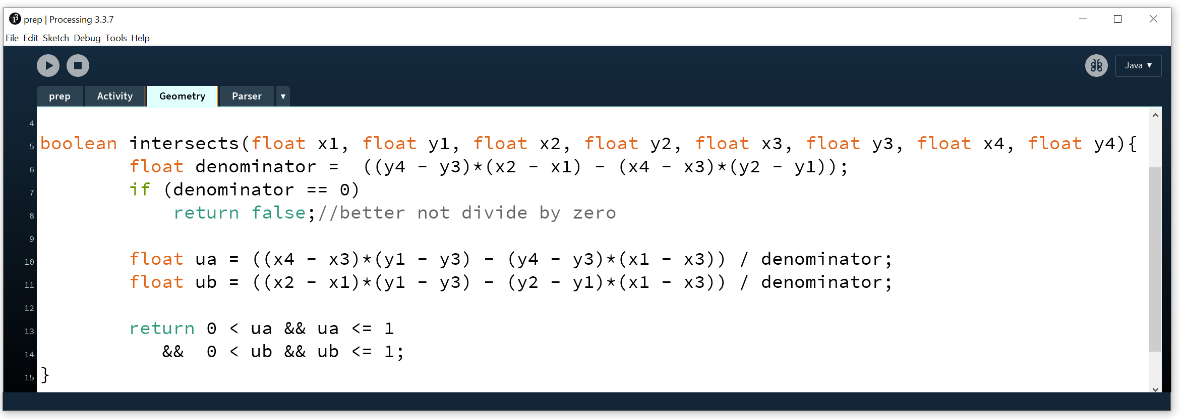
x₂,y₂
x₄,y₄
x₁,y₁
x₃,y₃

Slide 21
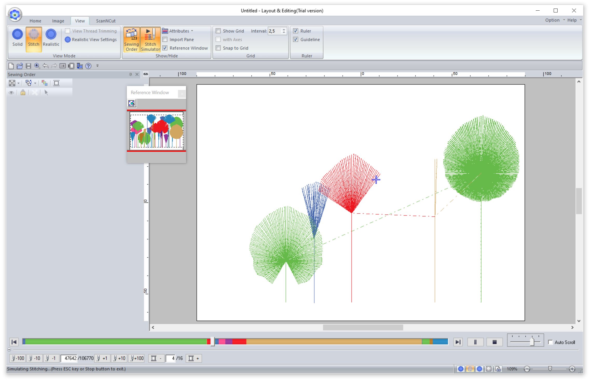

Slide 22
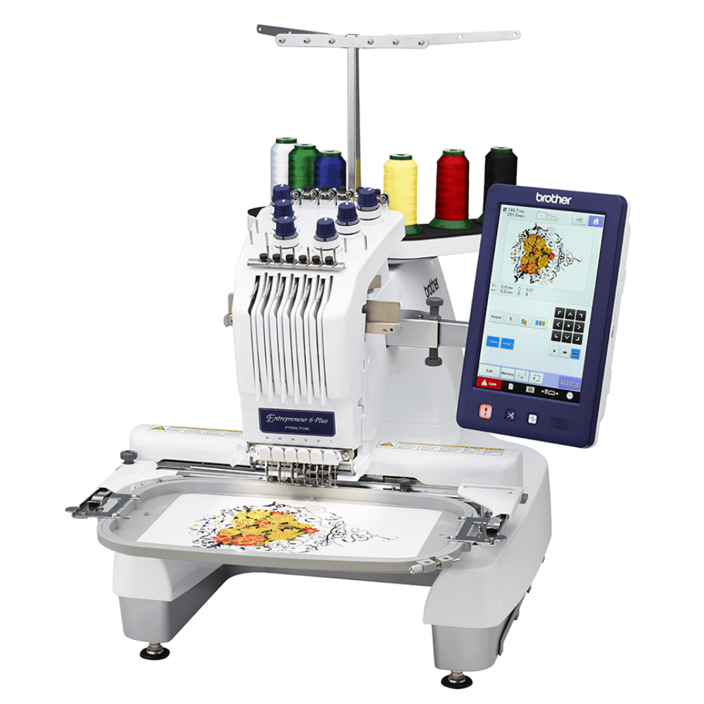
Prepare for production machines
Laser cutter:
avoid double lines
Embroidery machine:
pfd > Illustrator > svg > PE Design
beginShape(); vertex(x,y); endShape(); avoids jumps
3D printer:
txt.println("G1 X“ + x +" Y"+ y +" E"+ e);

Slide 23
Looking back
preliminaries
Geometry
Colors
setup, draw
size, for, int
Import file data
Produce rich patterns
Play with randomness
Avoid overlapping objects
Prepare for production machines

Slide 24
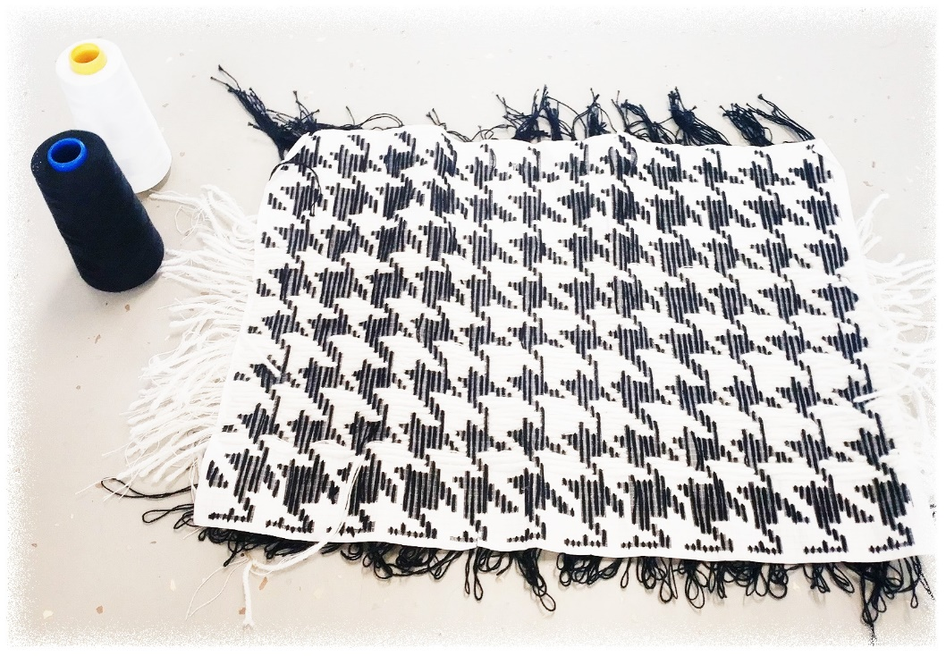
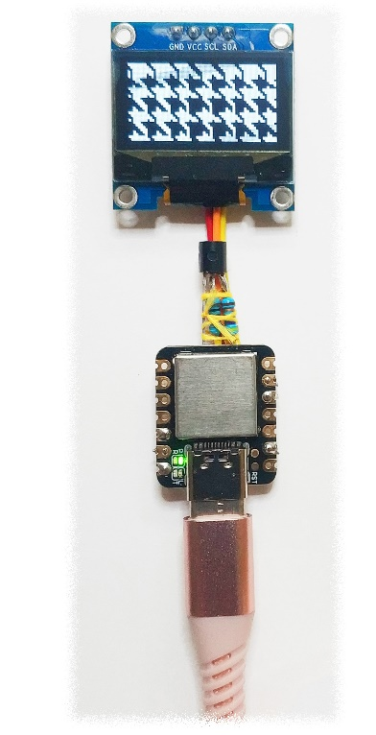
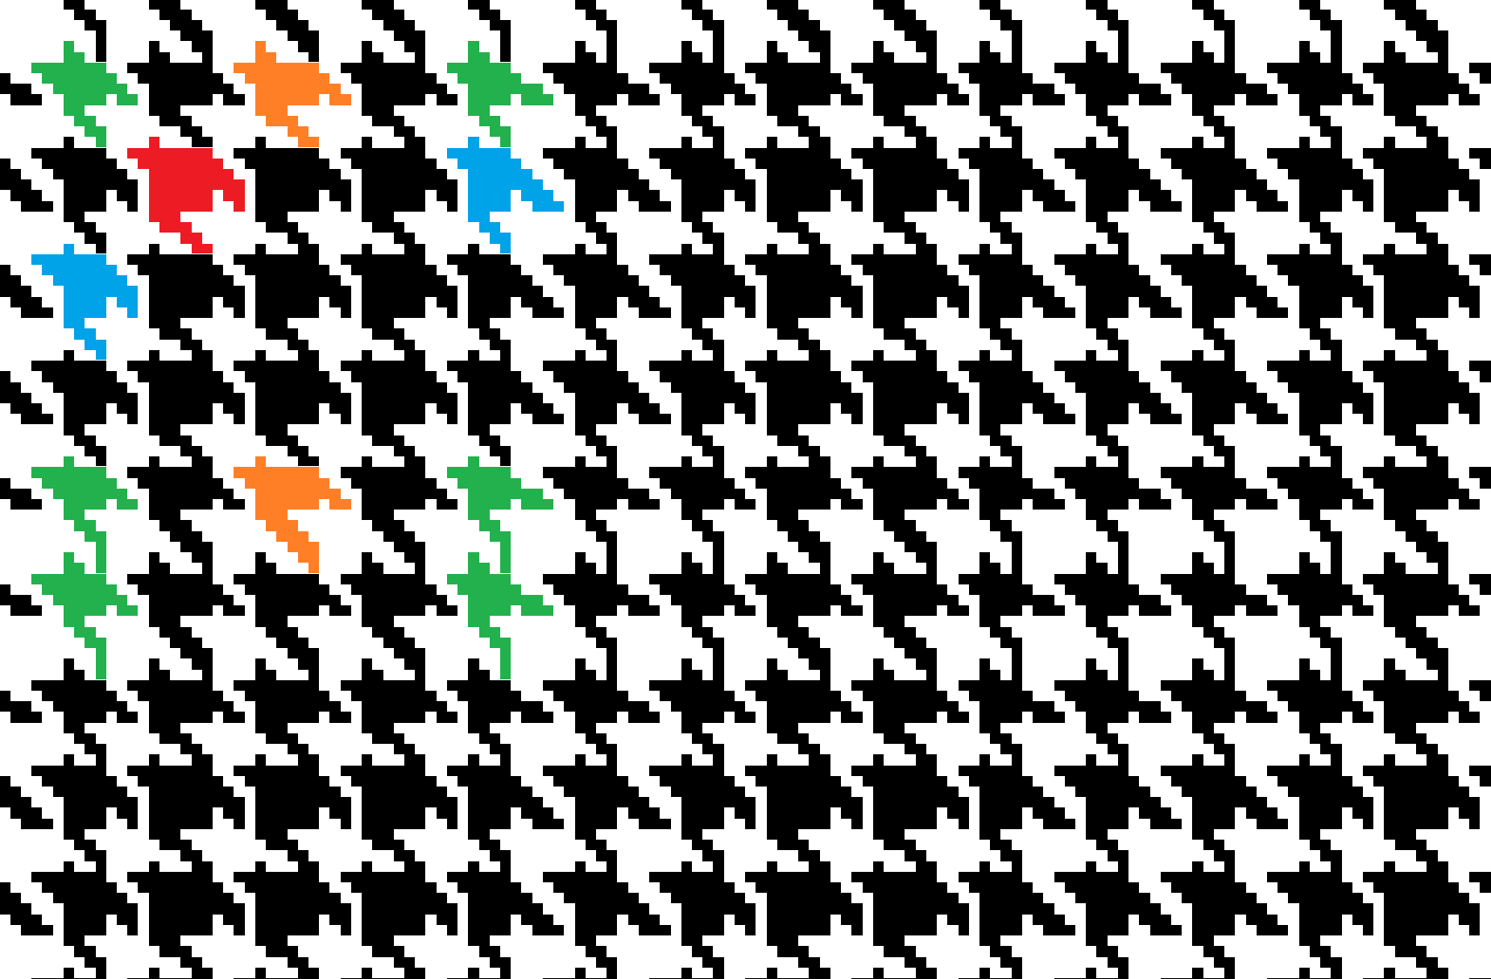
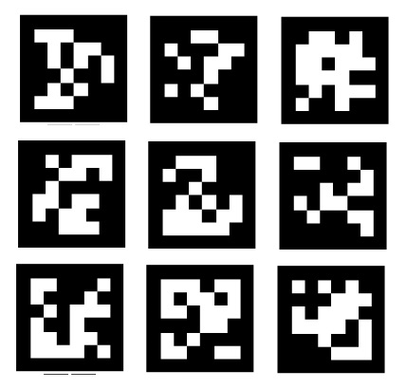
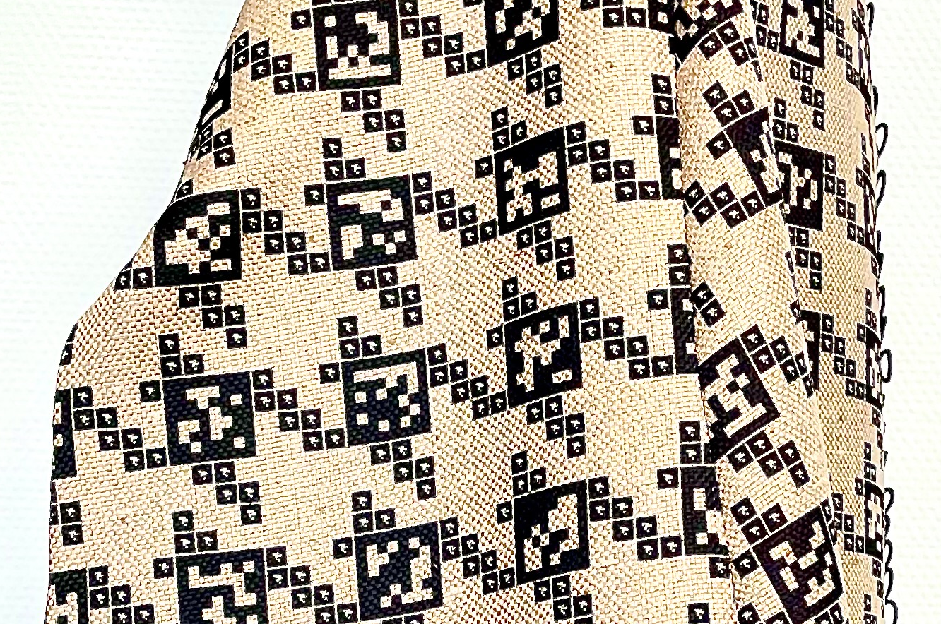
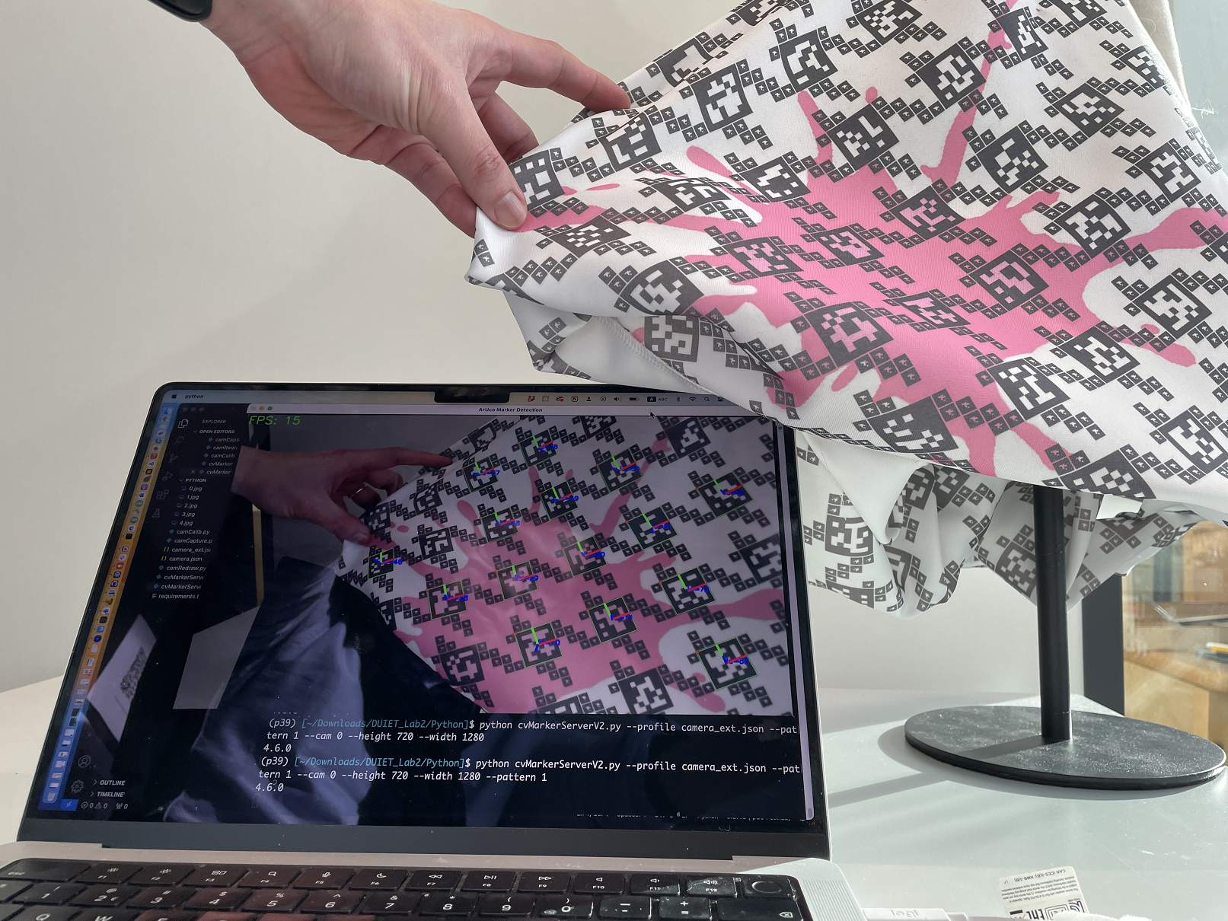
Recent work: weaving patterns from (aperiodic) data
Joint work with Rong-Hao Liang, Holly Krueger and Marina Toeters

